Slide 1
Descriptive Writing
A mini-unit that focuses on improving word choice to write more descriptively.

Slide 2
What is Descriptive Writing?
Descriptive writing is writing that uses precise words and phrases to paint a vivid picture for the reader.
Writers use descriptive writing to create setting, situations, problems, characters, and more.

Slide 3
Descriptive Writing is NOT…
narrative writing
an independent genre of writing
using as many adjectives as possible

Slide 4
Descriptive Writing IS…
the use of vivid adjectives, adverbs, and strong verbs
the use of figurative language
the use of imagery
the use of sensory details
being aware of denotative and connotative meanings
showing the reader rather than telling the reader

Slide 5
Word Choice
Adjectives
Adverbs
Strong Verbs
Words that describe and modify nouns
EX: yellow, bumpy, grotesque
Words that describe and modify verbs
EX: swiftly, steadily,
Descriptive verbs that show the action to the audience
EX: using noticed instead of saw, using gazed instead of looked

Slide 6
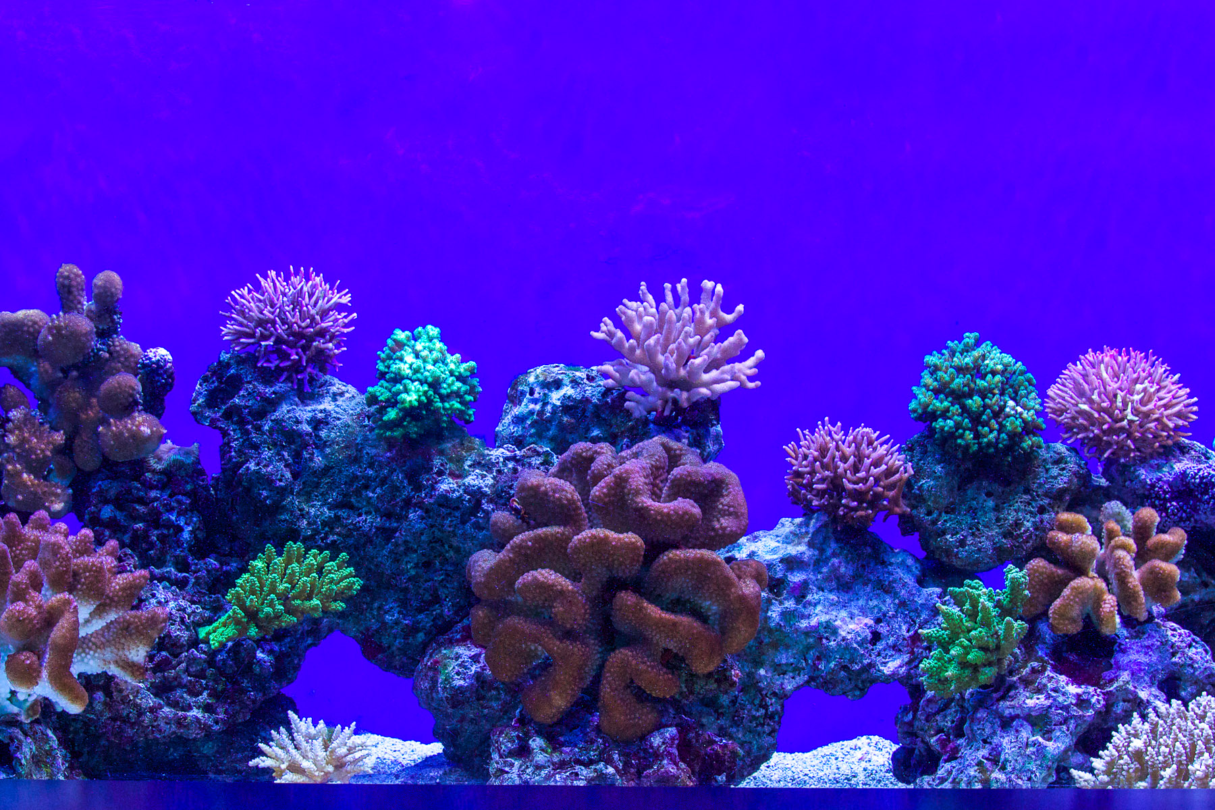
Word Choice: Your Turn
Adjectives
Write as many adjectives as you can to describe the picture.

Slide 7
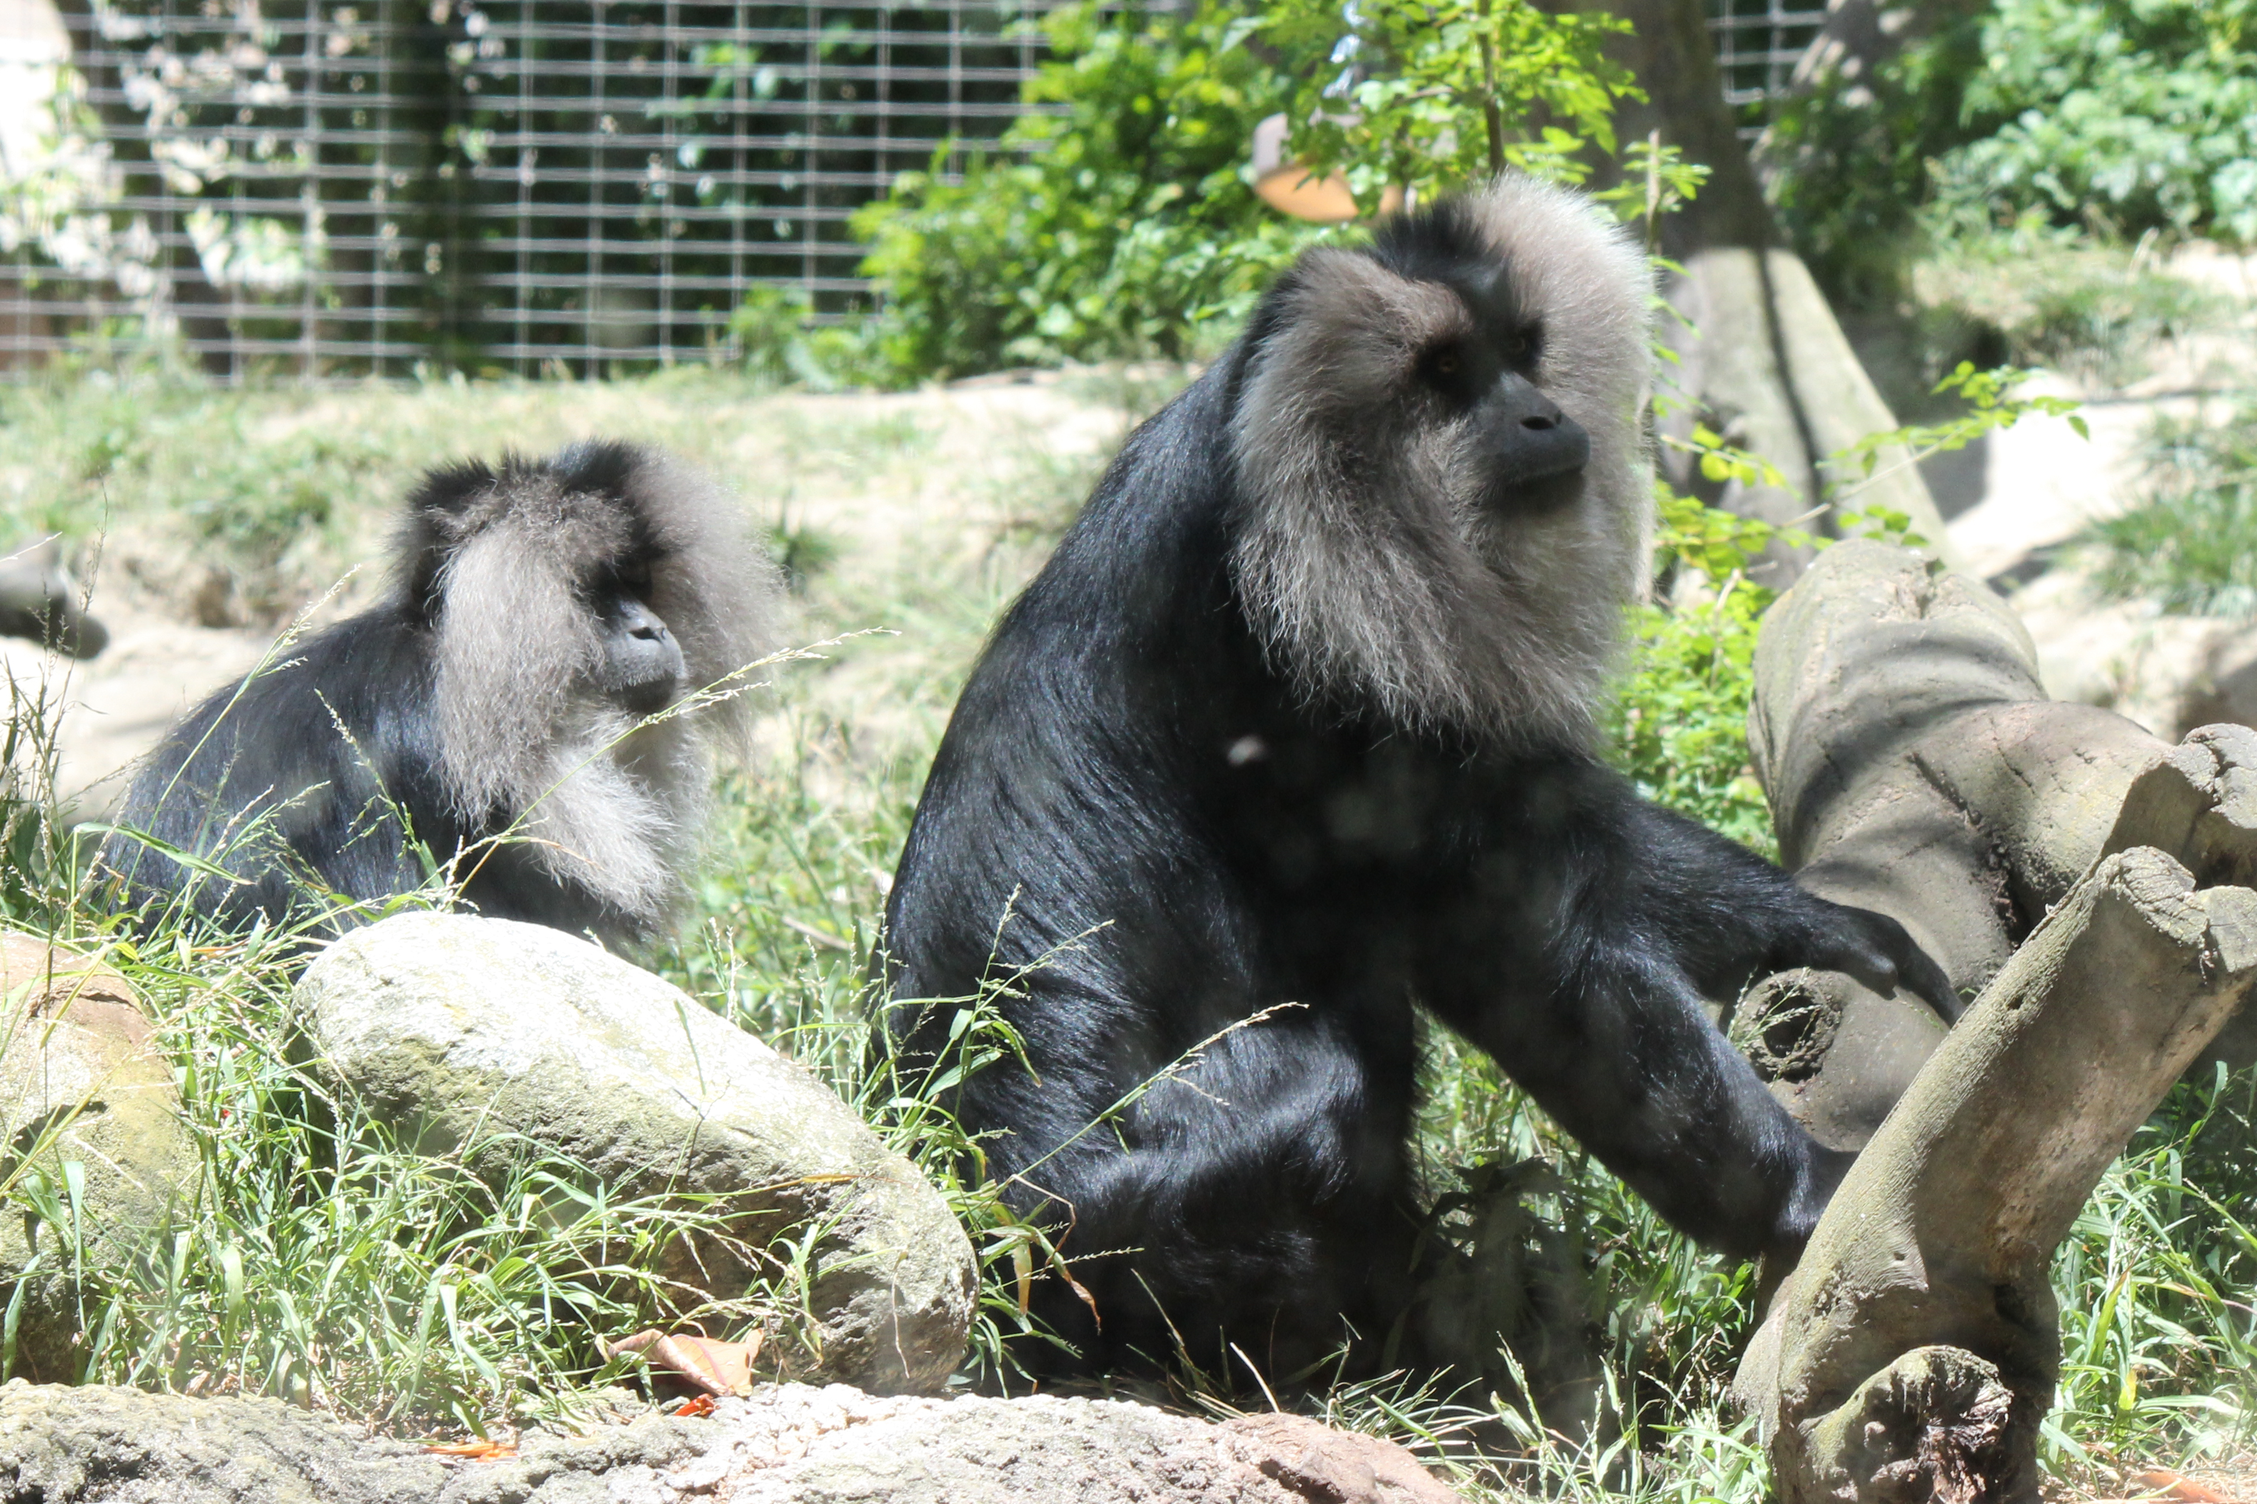
Word Choice: Your Turn
Adverbs
Write as many adverbs as you can to describe the action in picture.

Slide 8
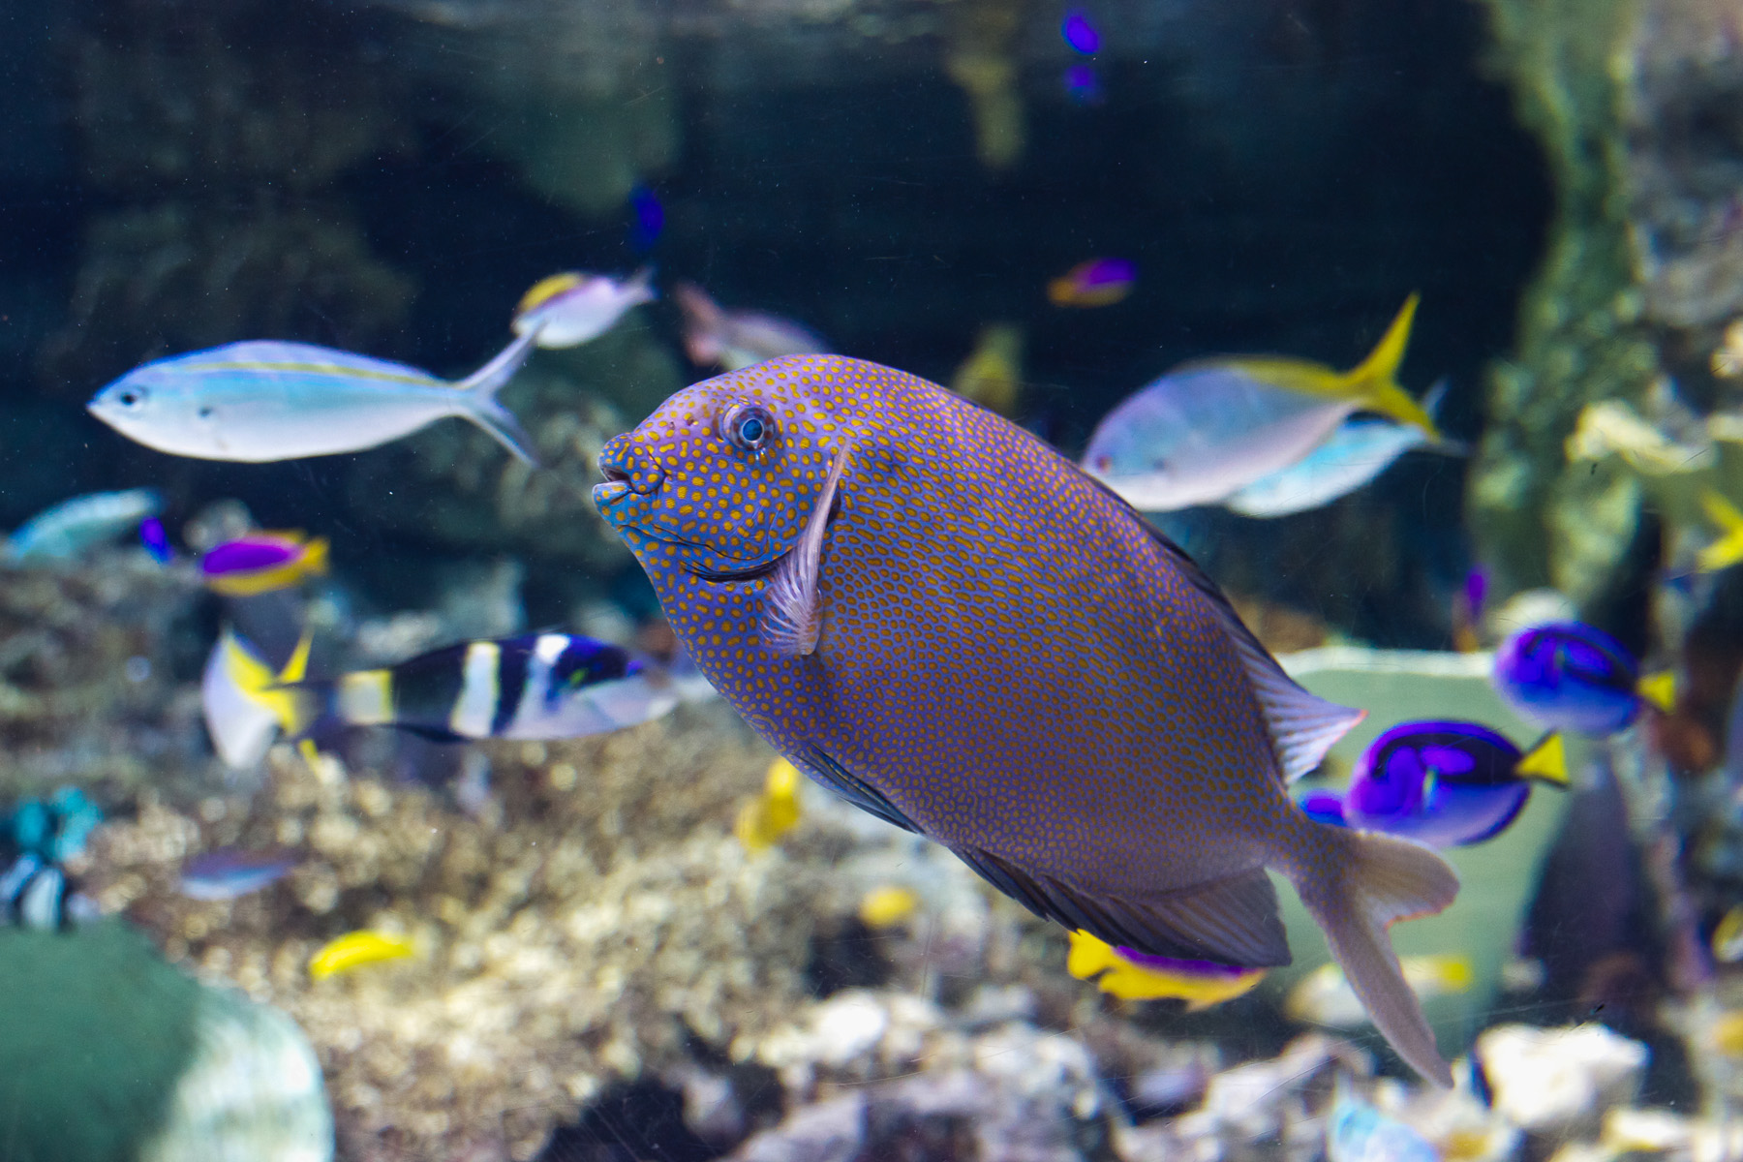
Word Choice: Your Turn
Strong Verbs
Write as many strong verbs as you can to show the action in picture.

Slide 9
Figurative Language
language that uses words or expressions with a meaning that is different from the literal interpretation.
language used intentionally that creates a special effect
Simile
Metaphor
Personification

Slide 10
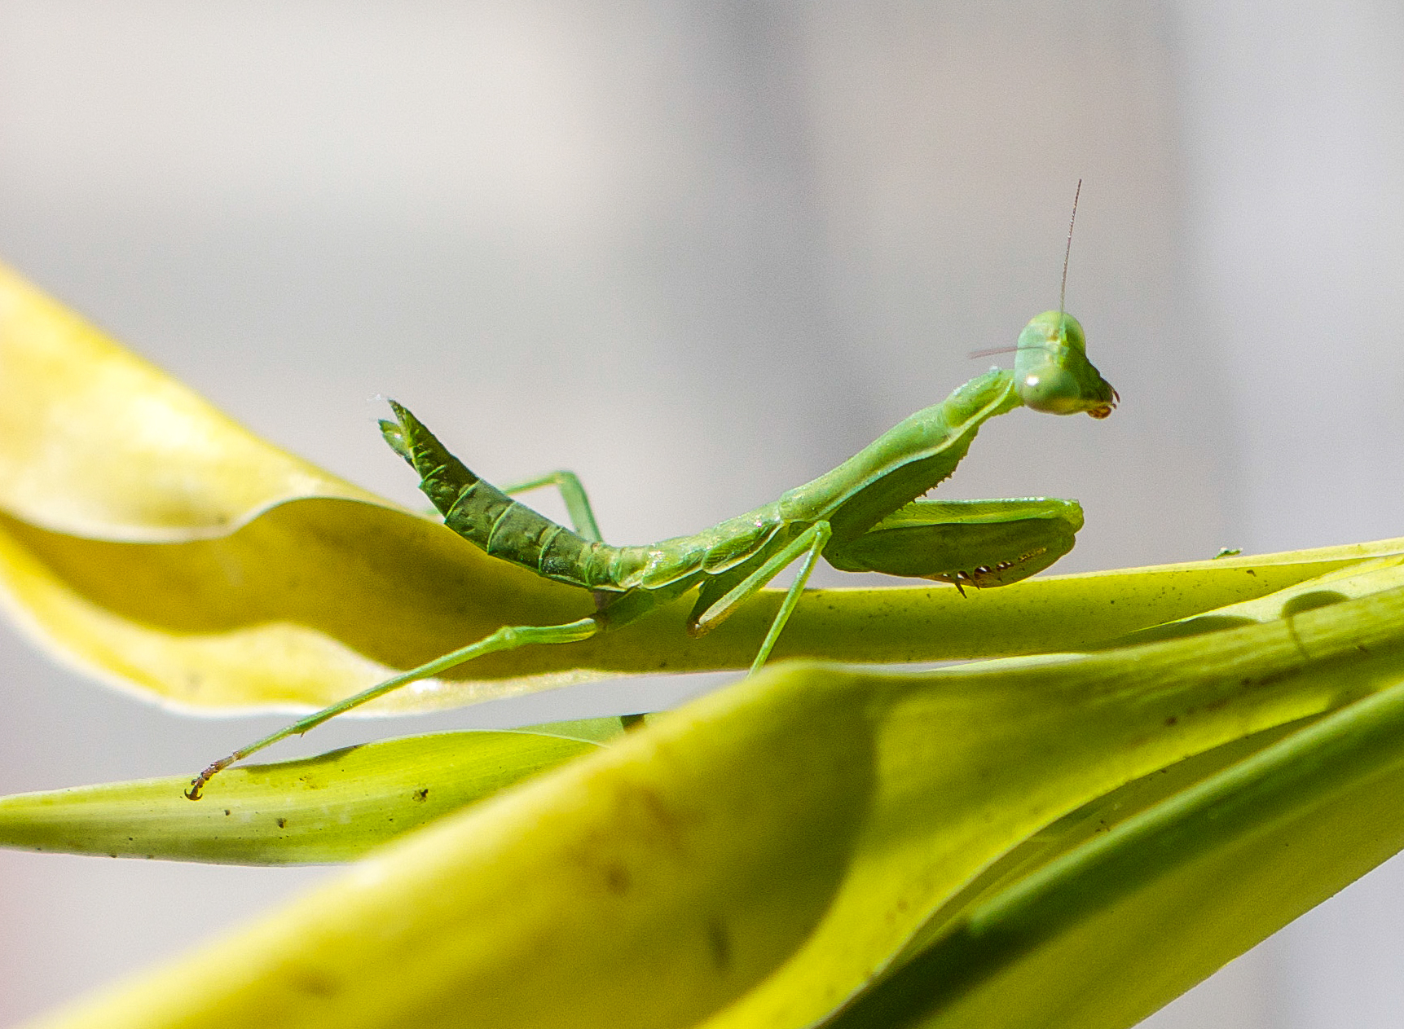
Simile
A comparison of two unlike objects using the words like or as.
EX: The praying mantis was as still as a statue.

Slide 11
Simile
The praying mantis was as still as a statue.
What is being compared in this statement?

Slide 12
Simile
The praying mantis was as still as a statue.
What is being compared in this statement?
The praying mantis is being compared to a statue

Slide 13
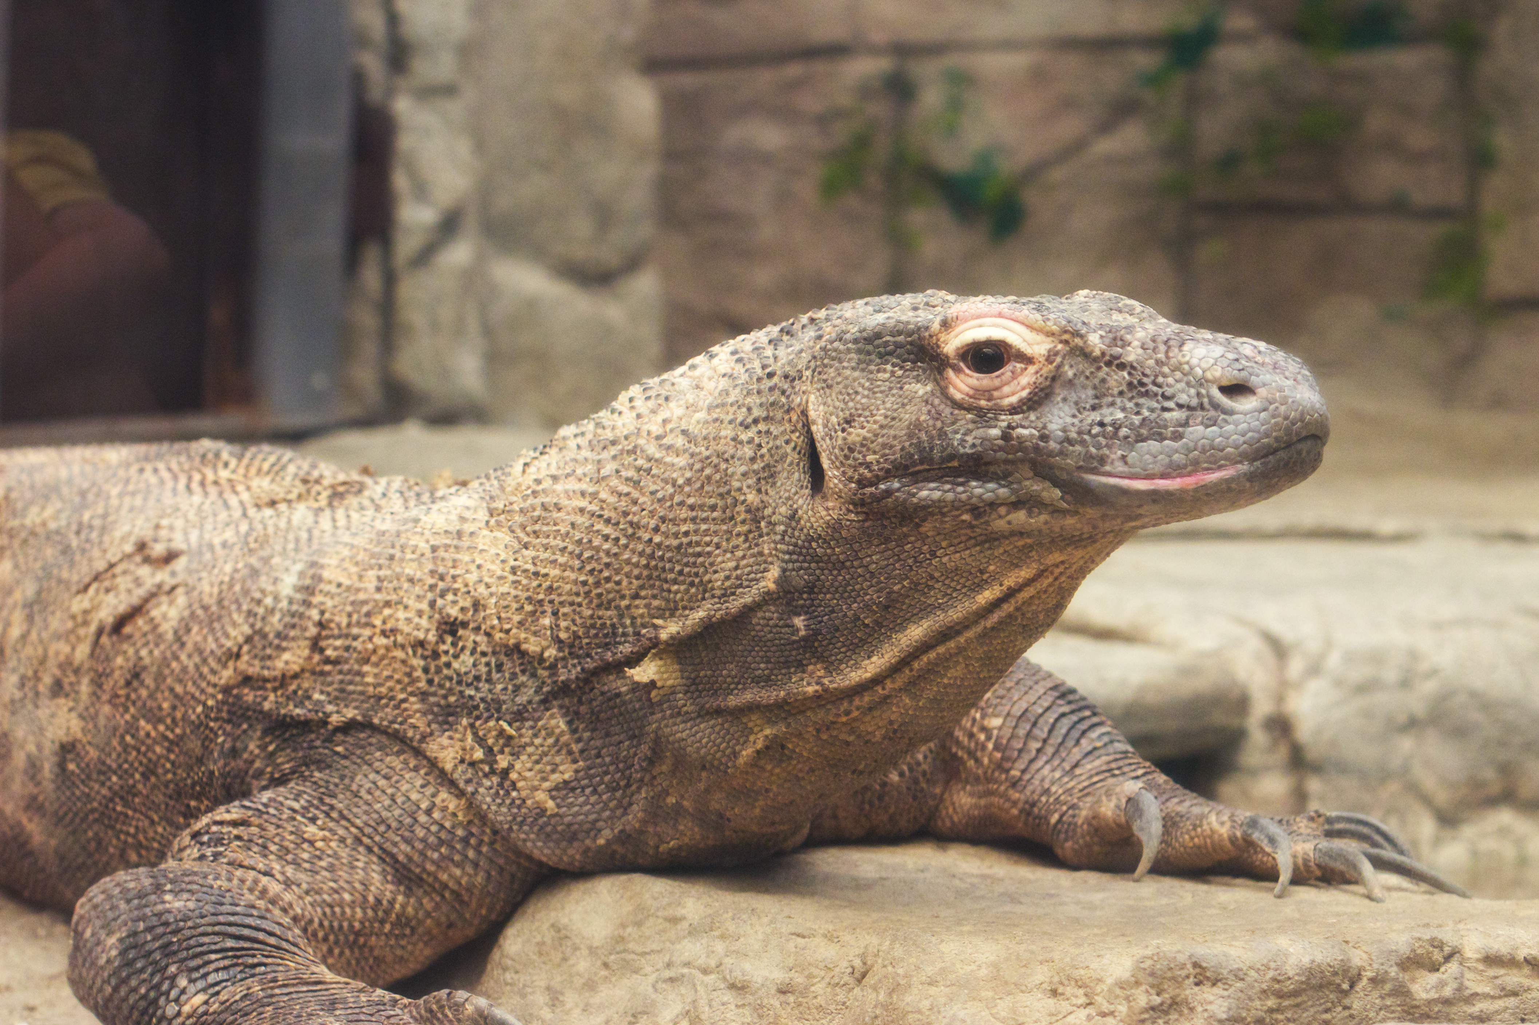
Simile: Your Turn
Write a simile for the picture of the komodo dragon.

Slide 14
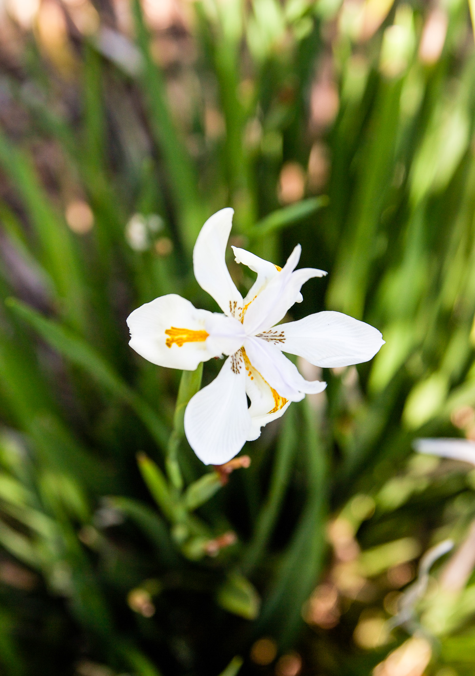
Metaphor
A word or phrase for one thing that is used to refer to another thing in order to show or suggest that they are similar
EX: Love is a fragile flower

Slide 15
Metaphor
Love is a fragile flower.
What is being compared in this statement?

Slide 16
Metaphor
Love is a fragile flower.
What is being compared in this statement?
Love is being compared to how fragile and delicate flowers can be.

Slide 17
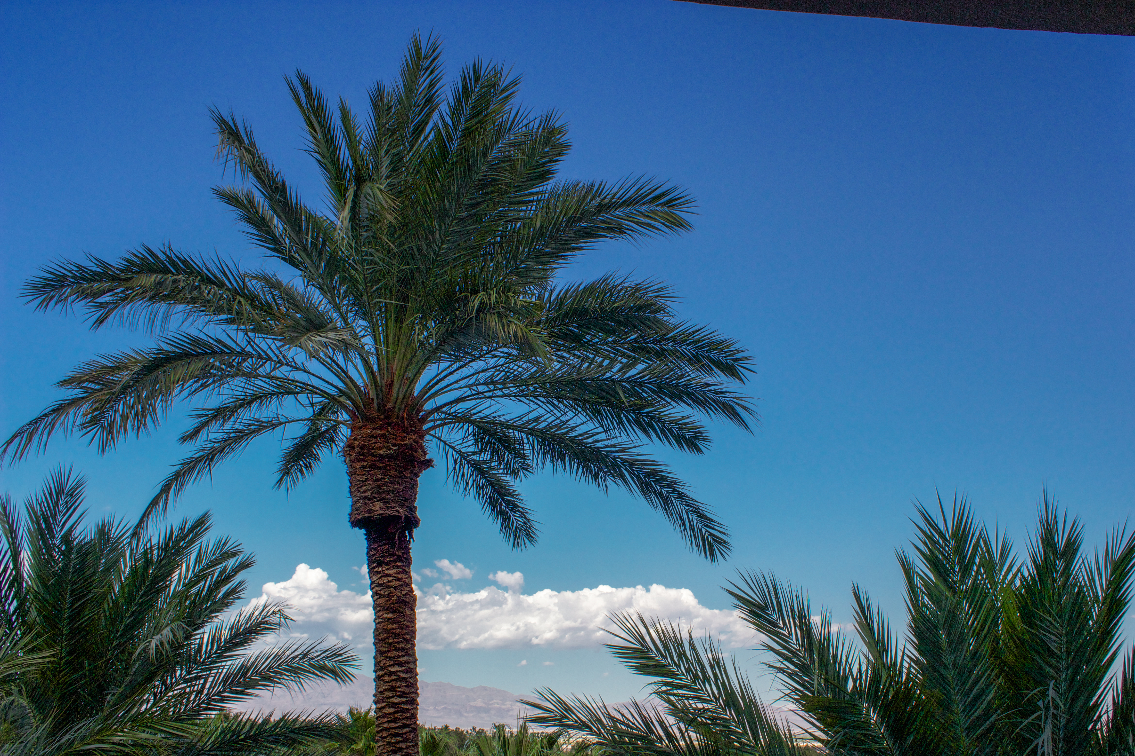
Metaphor: Your Turn
Write a metaphor for the picture of the palm tree

Slide 18
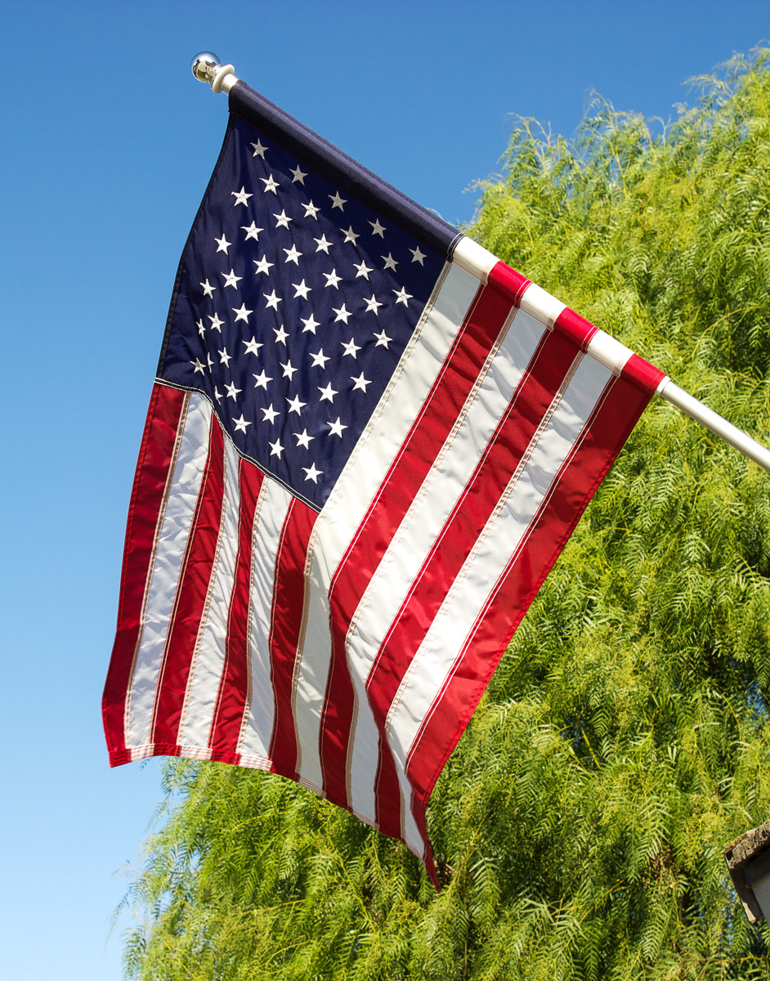
Personification
Giving human characteristics or qualities to inanimate objects.
EX: The American flag danced proudly in the wind.

Slide 19
Personification
The American flag danced proudly in the wind.
What human characteristic is given to the flag in this statement?

Slide 20
Personification
The American flag danced proudly in the wind.
What human characteristic is given to the flag in this statement?
Danced. Flags can’t dance.

Slide 21
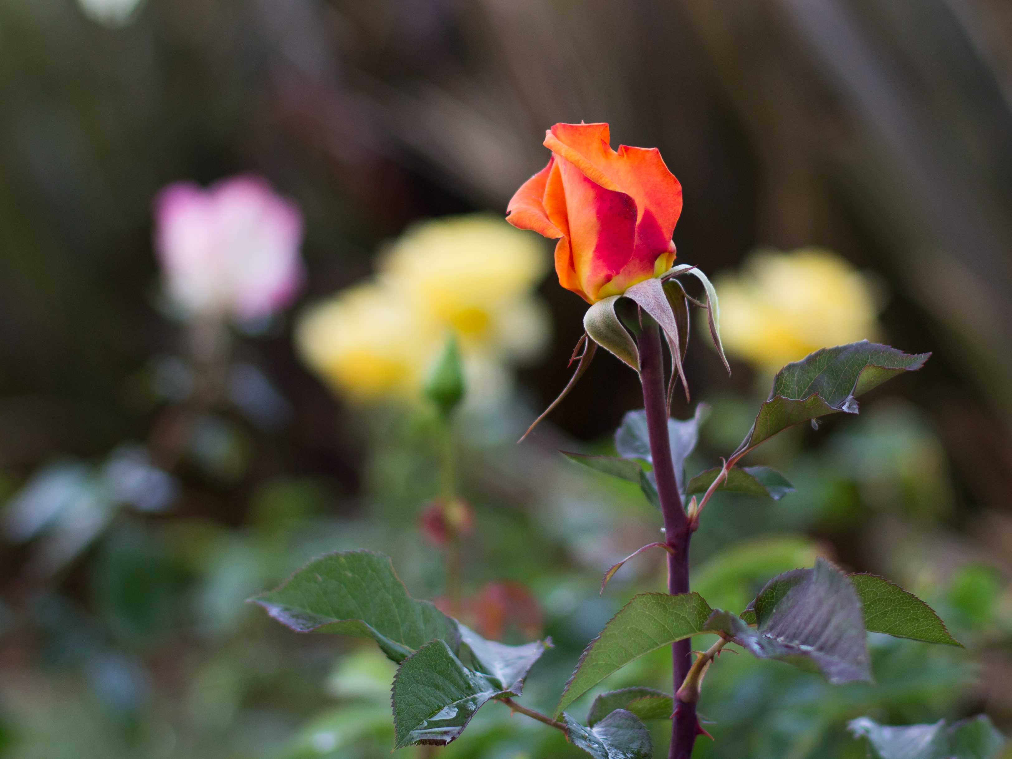
Personification: Your Turn
Using the picture of the rose, use personification to give it human traits.

Slide 22
Imagery
Vivid, descriptive writing that uses figurative and descriptive language to paint a picture in the reader’s head.

Slide 23
Imagery
Read this passage. What do you see?
Two brightly-colored blue and yellow macaws perched high in a luscious tree snacked delightedly as a gentle breeze cooled the afternoon air.

Slide 24
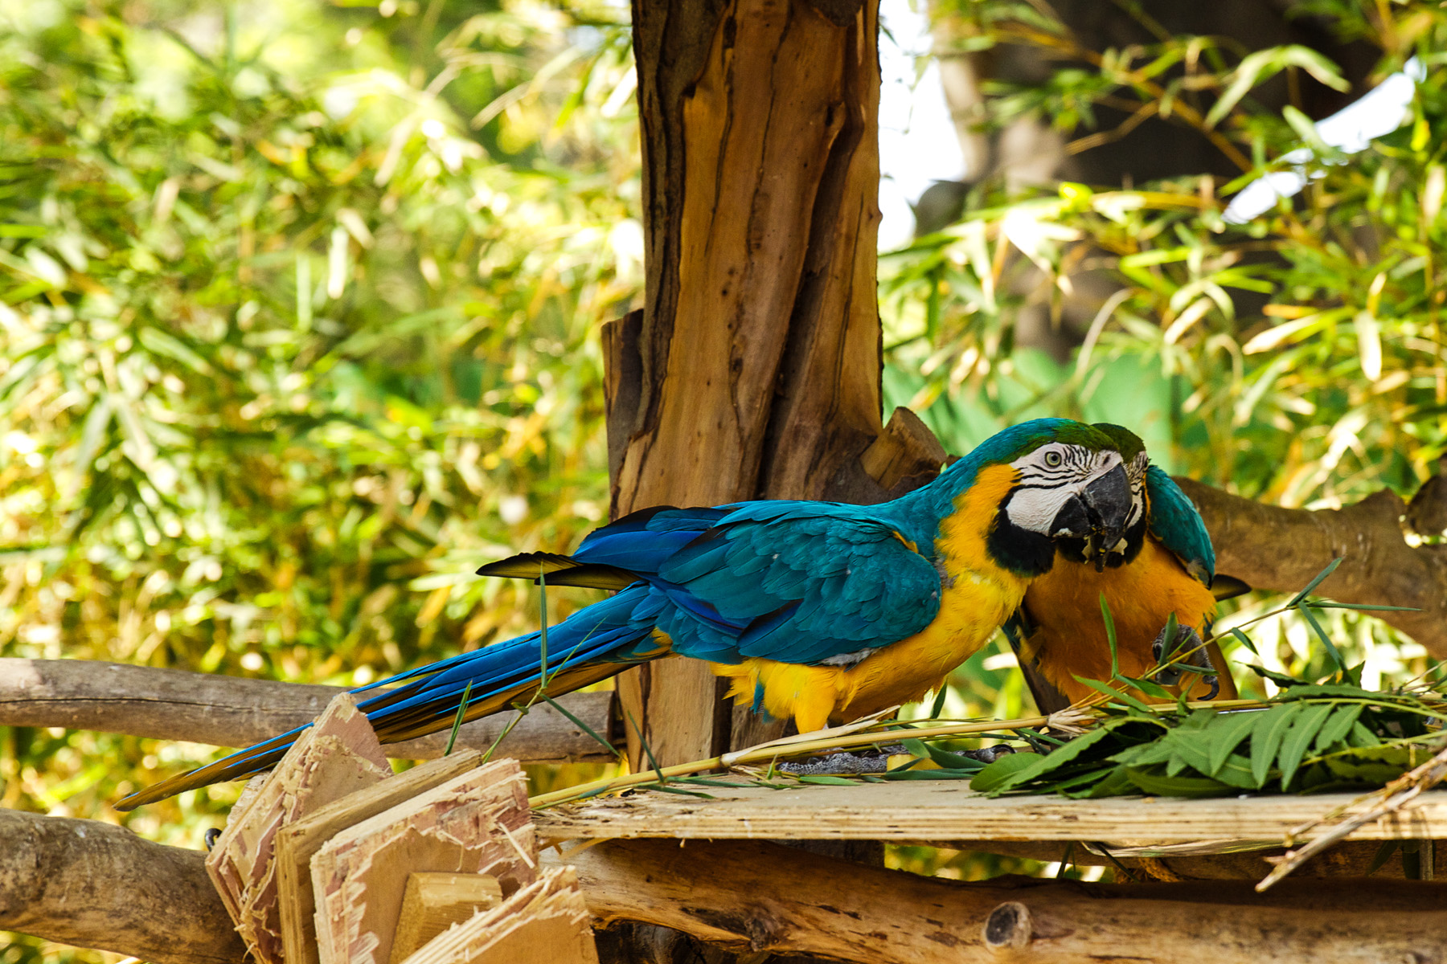
Imagery
Did you see something like this?

Slide 25
Imagery
Which words enhance the imagery?
Two brightly-colored blue and yellow macaws perched high in a luscious tree snacked delightedly as a gentle breeze cooled the afternoon air.

Slide 26
Imagery
These words enhance the imagery
Two brightly-colored blue and yellow macaws perched high in a luscious tree snacked delightedly as a gentle breeze cooled the afternoon air.

Slide 27
Sensory Details
Writing that appeals to the five senses.
Touch
Taste
Smell
Sight
Hearing

Slide 28
Sensory Details
Writing that appeals to the five senses.
Touch – what does it feel like?
Taste – what does it taste like?
Smell – what does it smell like?
Sight – what does it look like?
Hearing – what does it sound like?
Writing to explain, describe, and appeal to all of the senses will improve your descriptive writing skills.

Slide 29
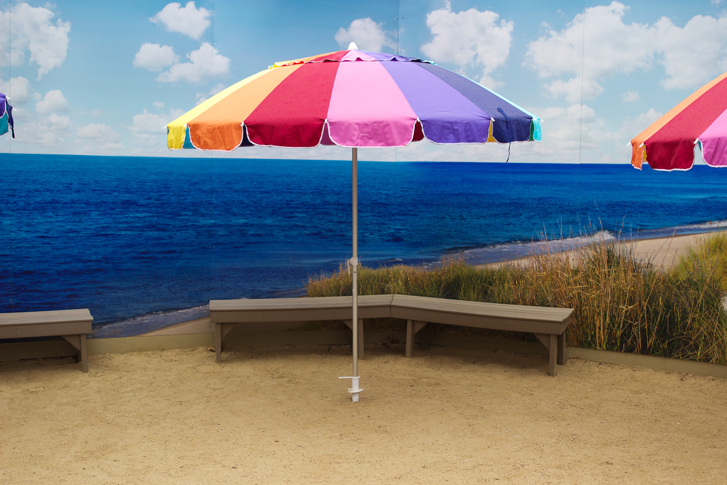
Sensory Details
Look at the picture.
What do you…
see?
hear?
smell?
touch?
taste?

Slide 30
Sensory Details
What do you…
see?
hear?
smell?
touch?
taste?
The Beach
At the beach, I felt the my feet sink in the golden, gritty sand. The azure Pacific rumbled softly as the waves greeted the shore. A soft breeze filled the air with a salty sea scent that was so dense the taste of salt lingered on my tongue.

Slide 31
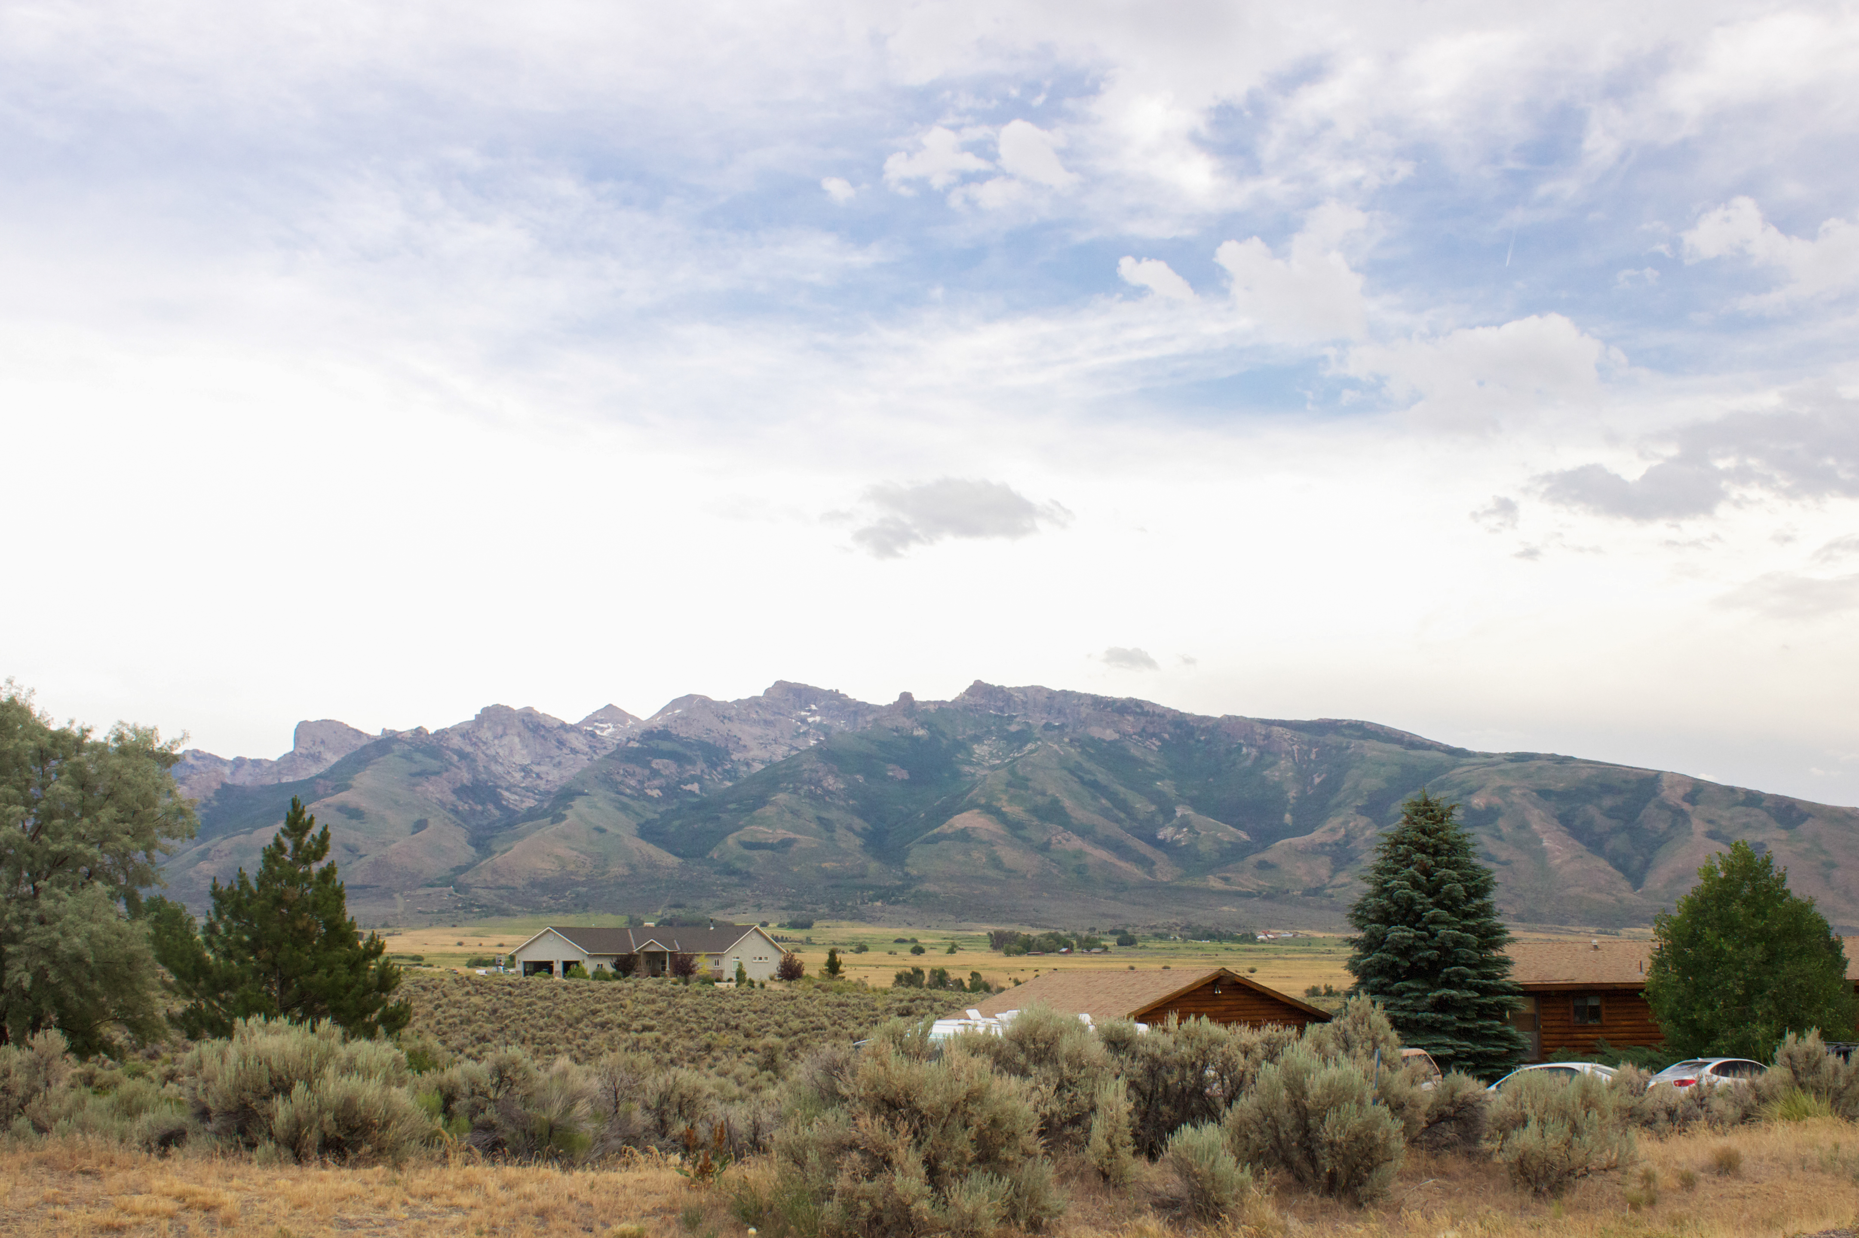
Sensory Details: Your Turn
What do you…
see?
hear?
smell?
touch?
taste?

Slide 32
Denotative and Connotative
Knowing words’ denotative and connotative meanings, and using those words wisely, will also improve the quality of your descriptive writing.

Slide 33
Denotative vs. Connotative
Denotative
Connotative
The direct and specific meaning of a word.
The word’s dictionary meaning.
Additional meaning associated with the word.
These additional meanings can come from emotions and ideas.

Slide 34
Denotative and Connotative
All of these words have similar meanings.
Callow
Juvenile
Immature
Inexperienced
Naïve
Which word would you rather be called? The word’s connotative meaning helped you answer this question

Slide 35
Denotative and Connotative
All of these words have similar meanings.
Callow
Juvenile
Immature
Inexperienced
Naïve
Label these words from most positive to least positive.

Slide 36
Denotative and Connotative
All of these words have similar meanings.
Amusing
Enjoyable
Fun
Pleasant
What kind of experience would you rather have? The word’s connotative meaning helped you answer this question.

Slide 37
Denotative and Connotative
All of these words have similar meanings.
Amusing
Enjoyable
Fun
Pleasant
Label these words from most positive to least positive.

Slide 38
More About Descriptive Writing
Now that you know to include adjectives, adverbs, strong verbs, figurative language, and sensory details into your descriptive writing, it is time to learn what NOT to include.

Slide 39
Avoid Dead Words
Dead words are words that are overused.
They take away meaning from your writing.
When you encounter a dead word in your writing, replace it with a more meaningful and insightful word.

Slide 40
Dead Words
Dead Word Examples
Fun
Stuff
Nice
Pretty
Awesome
Big
Bad
Very
A lot
Thing
Totally
Good
Incredible
Said
Small

Slide 41
Dead Words
What is another way to say
A lot

Slide 42
Dead Words
What is another way to say
Awesome

Slide 43
Dead Words
What is another way to say
Fun

Slide 44
Avoid TOO many adjectives
Adding in too many adjectives into your writing will be distracting.
Instead, remember to use figurative language, sensory details, adverbs and strong verbs.

Slide 45
Avoid TOO many adjectives
The bright, colorful, big, fun, cheerful, beach umbrella provided shade from the bright, radiating, hot, yellow, scorching sun.
Too many
adjectives
take away
from your
writing!

